Slide 1
D2 Summary
Sentence Selection Solution
Brandon Gahler Mike Roylance
Thomas marsh

Slide 2
Architecture: Technologies
Python 2.7.9 for all coding tasks
NLTK for tokenization, chunking and sentence segmentation.
pyrouge for evaluation

Slide 3
Architecture: Implementation
Reader:
Topic parser reads topics and generates filenames
Document parser reads documents and makes document descriptors
Document Model:
Sentence Segmentation and “cleaning”
Tokenization
NP Chunker
Summarizer - creates summaries
Evaluator - uses pyrouge to call ROUGE-1.5.5.pl

Slide 4
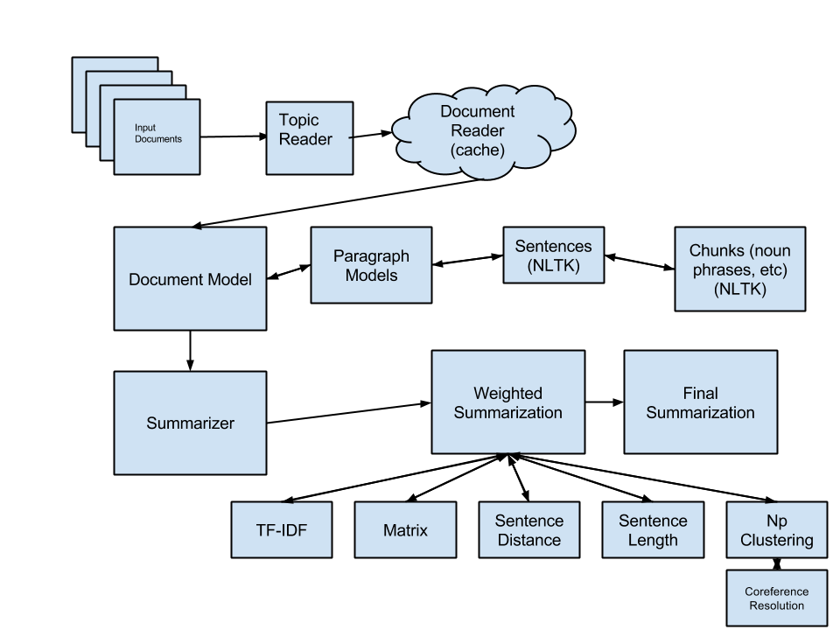
Architecture: Block Diagram

Slide 5
Summarizer
Employed Several Techniques:
Each Technique:
Computes rank for all sentences normalized from 0 to 1
Is given a weight from 0 to 1
Weighted sentence rank scores are added together
Overall best sentences are selected from the summary sum

Slide 6
Summary Techniques
Matrix Similarity Measure
NP Clustering
Sentence Location
Sentence Length
Simple tf-idf

Slide 7
Simple Techniques
Sentence Position Ranking - Highest sentences get highest rank
Sentence Length Ranking - Longest sentences get best rank
tf-idf - All non-stop words get tf-idf computed and added. Sentences with the highest sum of tf-idf get best rank.
We use the gigaword corpus as a background corpus.

Slide 8
Matrix Similarity Technique
Iterate:
Find the common words of all sentences
Compute the most connected sentence
Mark that sentence as highest rank
Change its value to negative
recompute

Slide 9
NP-Clustering Technique
Compute the most connected sentences:
Use coreference resolution:
Find all the pronouns, and replace them with their antecedent
Compare just the noun phrases of each sentence with every other sentence.
Use edit distance for minor forgiveness
Normalize casing
Highest score sentences win
Rank every sentence with normalized metric between 0-1, with the highest being 1

Slide 10
Technique Weighting
It is difficult to tell how important each technique is in contributing to the overall score. Because of this, we established a weight generator which did the following:
for each technique:
compute unweighted sentence ranks.
Iterate weights of each technique from 0 to 1 at intervals of 0.1
for each weight set:
rank sentences based on new weights
generate rouge scores
At the end, the best set of weights is the one with the optimal score!

Slide 11

Optimal Weights
AAANNND... the optimal set of weights turns out to be:
Disappointing!
It turned out that none of our fancy techniques were able to even slightly improve the performance of tf-idf by itself.

Slide 12
Optimal Weights
The Sad (but empirically determined!) Optimal Technique Weights:
Technique | Weight
tf-idf | 1.0
Matrix Summary | 0.0
NP-Clustering | 0.0
Sentence Position | 0.0
Sentence Length | 0.0

Slide 13
Best Results
Average ROUGE scores for our final (tf-idf-only) solution:
ROUGE Technique | Recall | Precision | F-Score
ROUGE1 | 0.55024 | 0.52418 | 0.53571
ROUGE2 | 0.44809 | 0.42604 | 0.43580
ROUGE3 | 0.38723 | 0.36788 | 0.37643
ROUGE4 | 0.33438 | 0.31742 | 0.32490

Slide 14
NP-Clustering Results
Average ROUGE scores for our final (NP-Clustering-only) solution:
ROUGE Technique | Recall | Precision | F-Score
ROUGE1 | 0.45691 | 0.53378 | 0.49056
ROUGE2 | 0.33306 | 0.39053 | 0.35813
ROUGE3 | 0.28221 | 0.33196 | 0.30386
ROUGE4 | 0.24758 | 0.29237 | 0.26700

Slide 15
Matrix Results
Average ROUGE scores for our final (Matrix-only) solution:
ROUGE Technique | Recall | Precision | F-Score
ROUGE1 | 0.48228 | 0.56860 | 0.52048
ROUGE2 | 0.36821 | 0.43541 | 0.39787
ROUGE3 | 0.31484 | 0.37348 | 0.34065
ROUGE4 | 0.27465 | 0.32683 | 0.29757

Slide 16
References
Heinzerling, B and Johannsen, A (2014). pyrouge (Version 0.1.2) [Software].
Available from https://github.com/noutenki/pyrouge
Lin, C (2004). ROUGE (Version 1.5.5) [Software]. Available from
http://www.berouge.com/Pages/default.aspx

